Slide 1






Requirements Analysis and Design
Group 18
The Audience: Mr. Pham Thai Ky Trung
The Presentation: Nguyen Van Hung – 520H0637
Le Huynh My Duyen – 520H0626

Slide 2
TABLE OF CONTENTS
1
2
3
4
5
Use case
Domain Diagram
State Diagram
Activity Diagram
UI

Slide 3
System capabilities
A Distributor selling electronics devices products to authorized resller/ agents, the new system should be capable of:
Accoutants shall be able to create Goods Received when the distributor imports goods (a warehouse receipt will include many items).
When receiving goods at the warehouse, warehouse staff will scan barcode/ QR code, RIFDs to perform goods warehousing process.
Reseller / Agents shall be able to place an order of items by themselves and choose a payment method (Cash, bank transfer, Momo...) and make an online payment and see the status of their orders.
The system allows accounting staff to make Goods Delivery Note (based on previously placed orders) to deliver goods to agents (print delivery slips), update the status of orders as being transferred and update the payment status of agents. Also, the system allows warehouse staff make use of barcode/ QR code/ RFIDs for stock out.
Accountants shall be able to view incoming/outgoing stock report (inventory movement), best-selling products and revenue report monthly.

Slide 4
Business Requirements

Slide 5
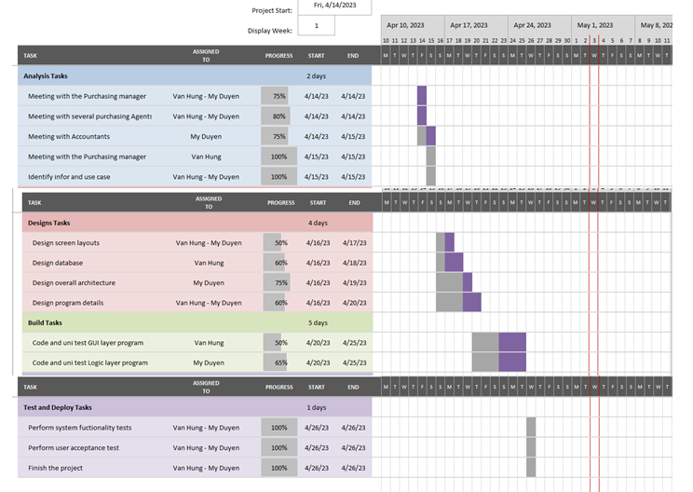
GANTT CHART

Slide 6
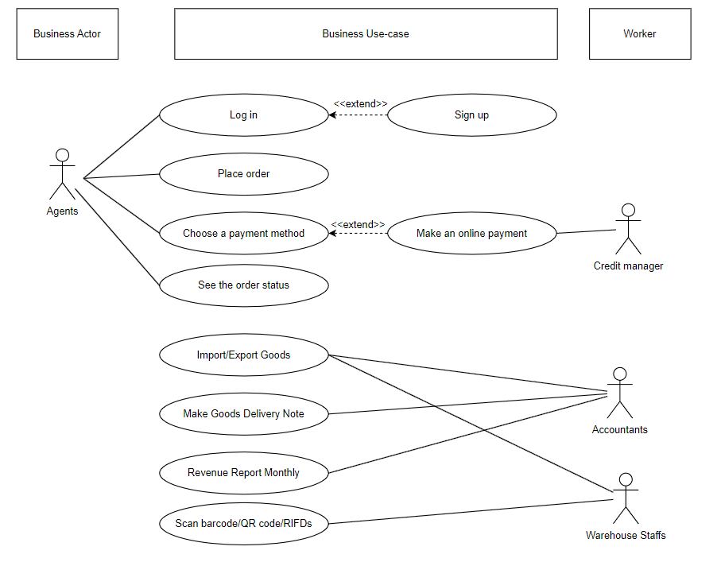
Business use – case diagram

Slide 7
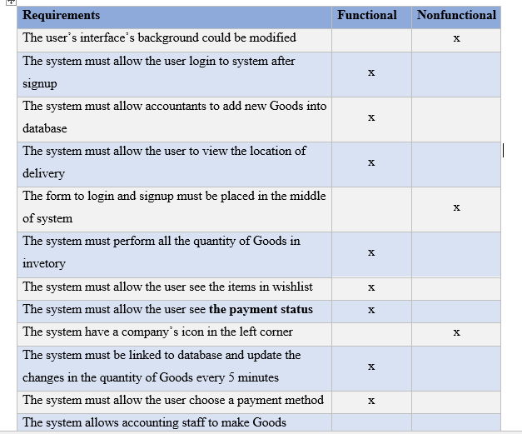
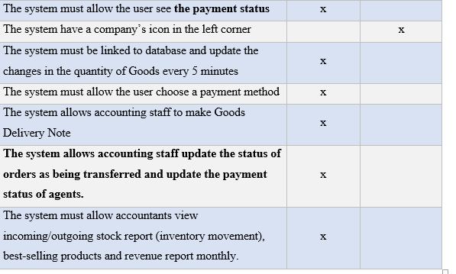
List of Requirements

Slide 8
USE CASE DIAGRAM

Slide 9
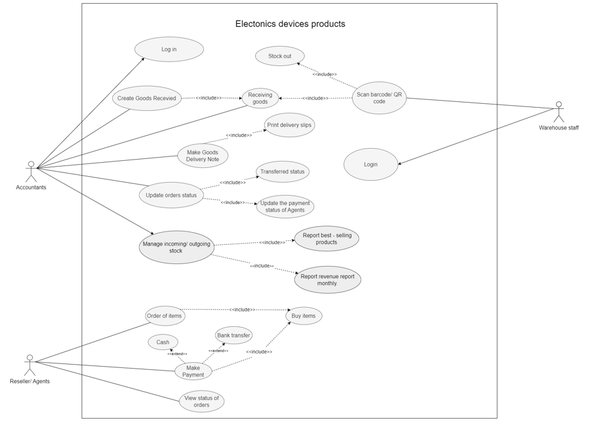
USE CASE
The system

Slide 10
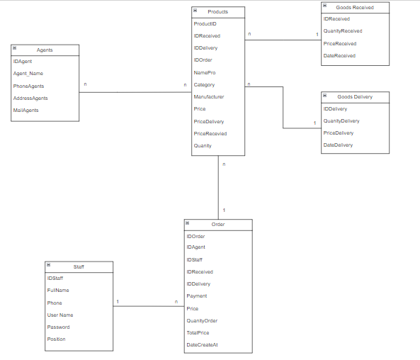
Domain Model Class Diagram

Slide 11
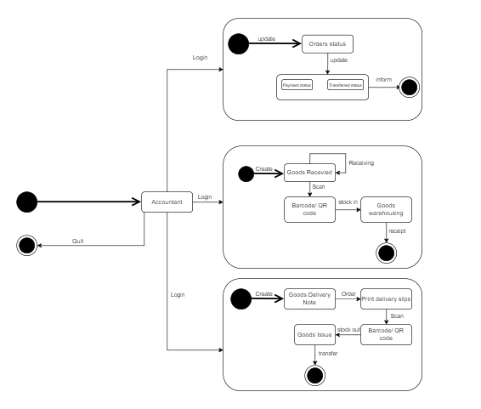
State Machine Diagram

Slide 12

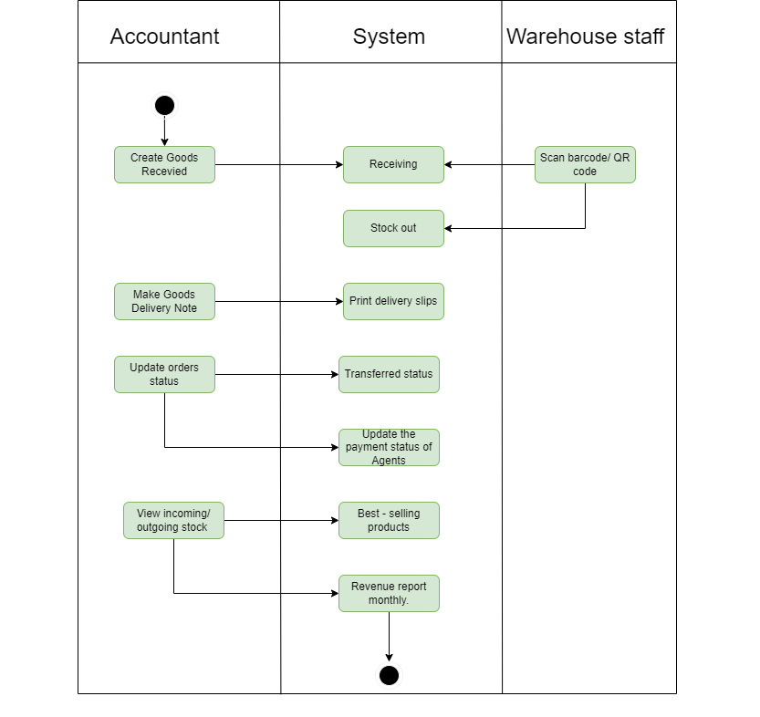
Activity Diagram

Slide 13

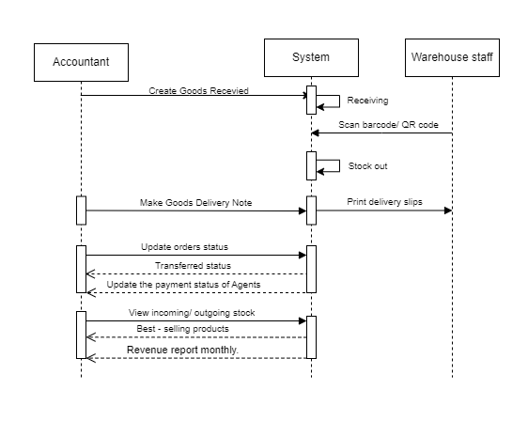
Sequence Diagram

Slide 14
USE CASE DESCRIPTIONS

Slide 15
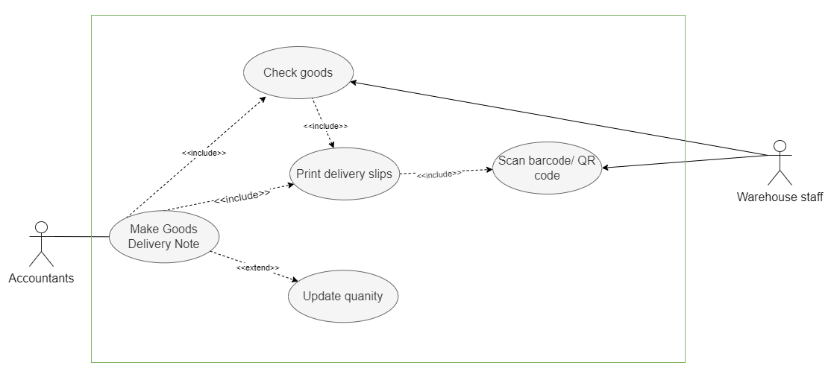
Make Goods Delivery Note

Slide 16

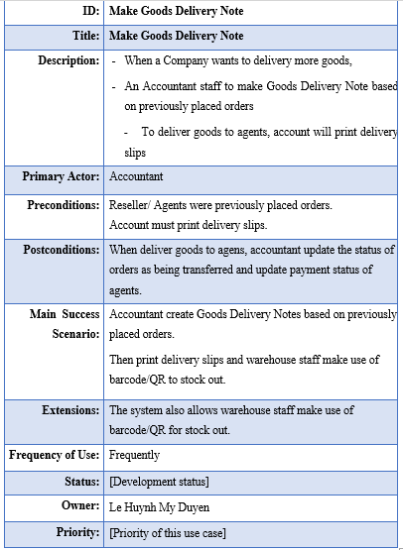


Use case description for Make Goods Delivery Note

Slide 17
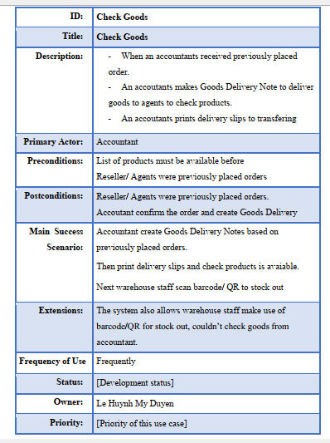
Use case description for Check Goods

Slide 18
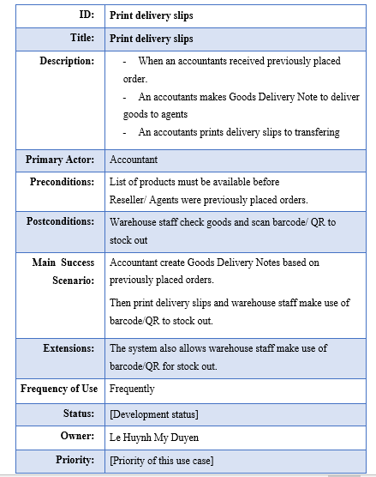
Use case description for Print delivery slips

Slide 19
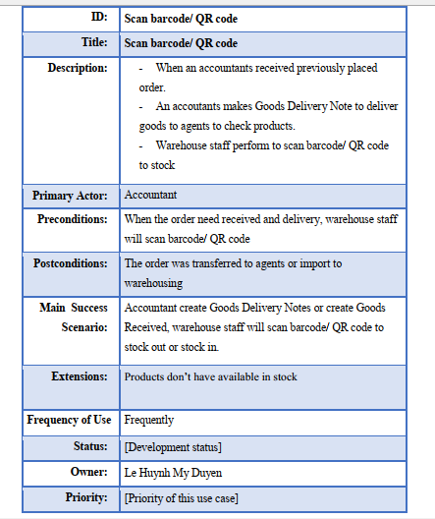
Use case description for Scan barcode/ QR code/ RFIDS

Slide 20
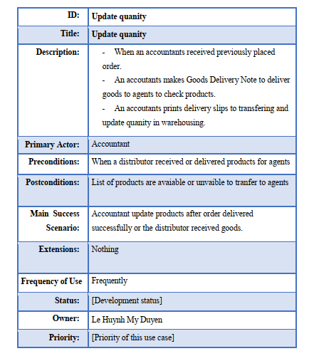
Use case description for Update quanity

Slide 21
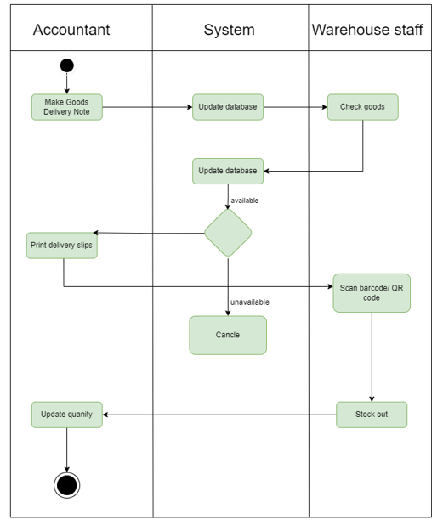
Activity Diagram Use Case: Make Goods Delivery Note

Slide 22
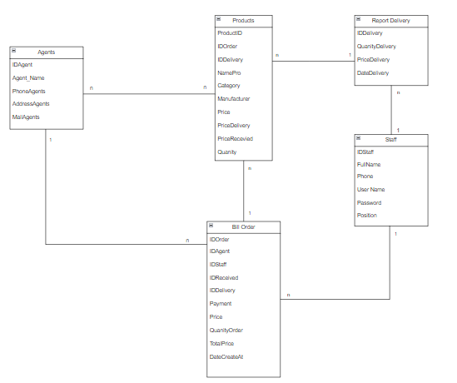
Domain Model Class Make Goods Delivery for Staff Subsystem Diagram

Slide 23
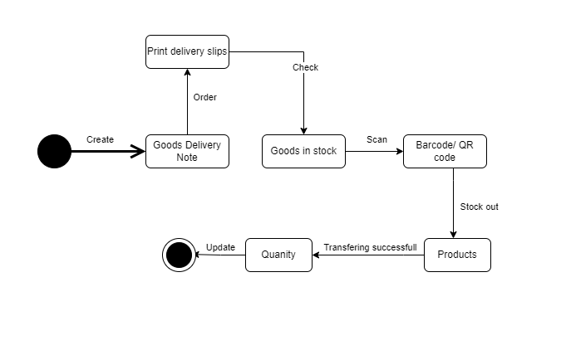
State Machine Diagram for Create Goods Delivery Note

Slide 24
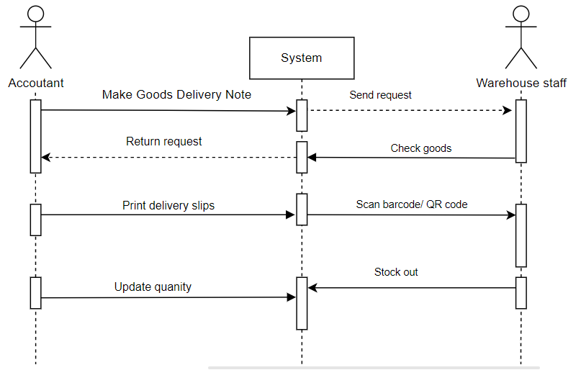
Sequence Diagram for
Make Goods Delivery Note

Slide 25
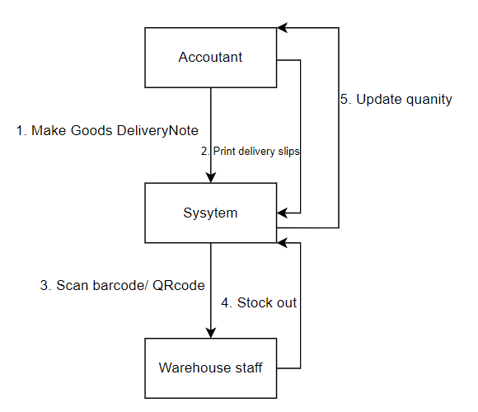
Collaboration
Make Goods Delivery Note

Slide 26
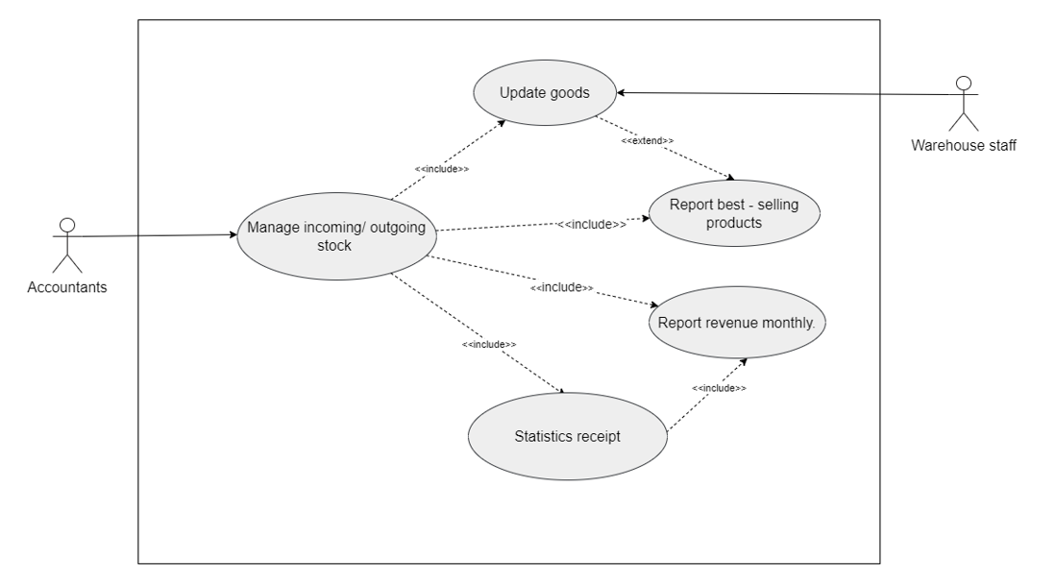
Manage warehouse activity

Slide 27
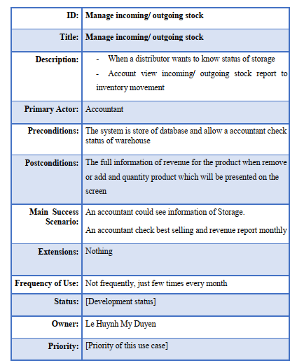
Use case description for Manage incoming/ outgoing stock

Slide 28
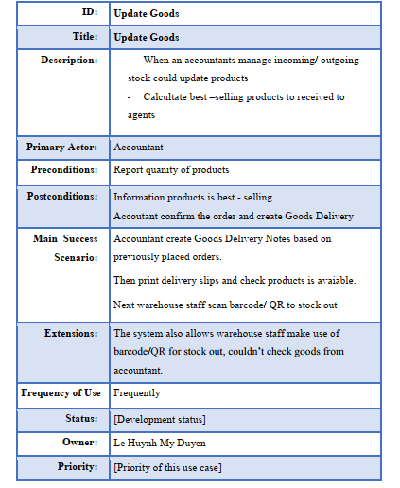
Use case description for Update Goods

Slide 29
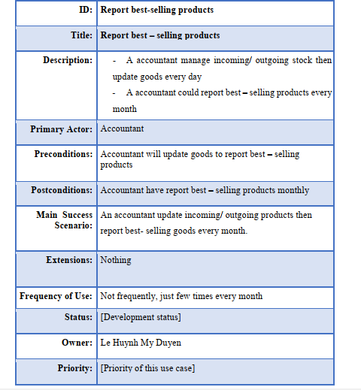
Use case description for Report best – selling products

Slide 30
Use case description for Report best – selling products

Slide 31
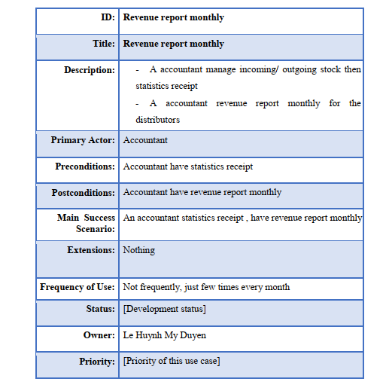
Use case description for Revenue report monthly

Slide 32
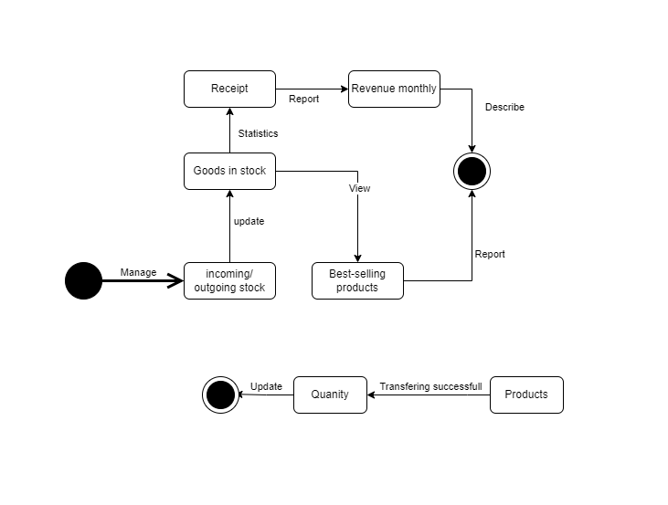
State Machine Diagram for Manage incoming/ outgoing stock

Slide 33
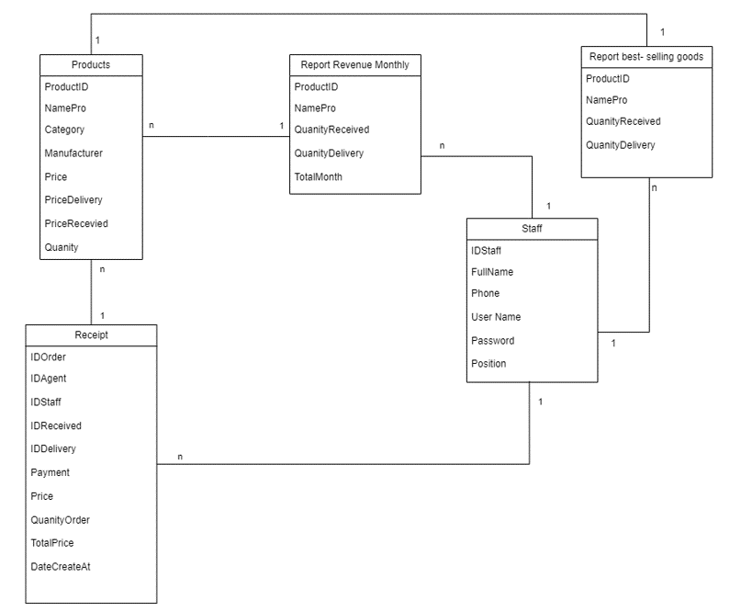
Domain Model Class Manage incoming/ outgoing stock for Staff Subsystem Diagram

Slide 34
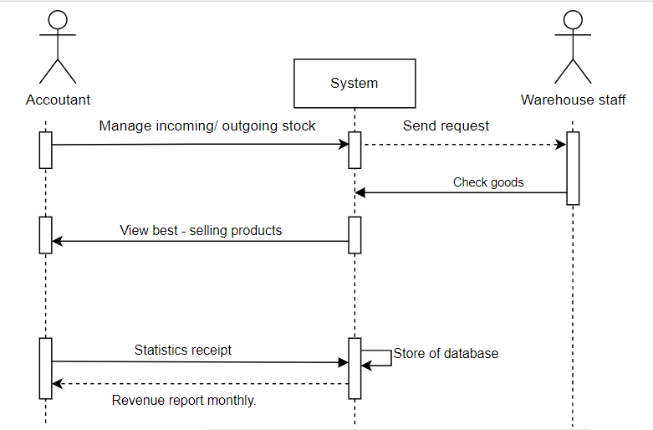
Sequence Diagram for
Manage incoming/ outgoing stock

Slide 35
Collaboration for
Manage incoming/ outgoing stock

Slide 36
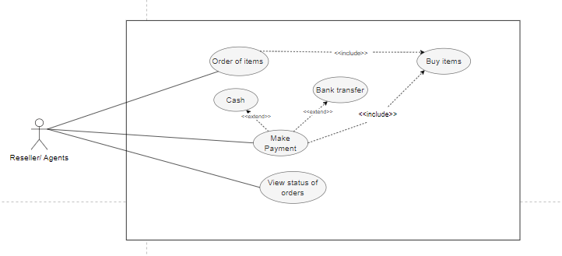
PAYMENT

Slide 37
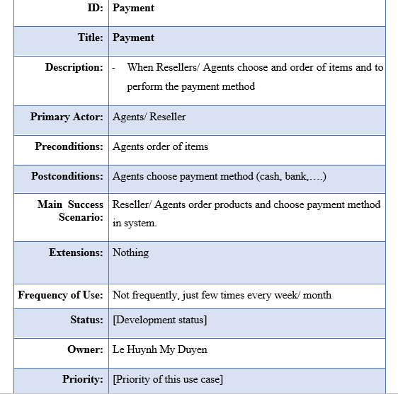
Use case description for Payment

Slide 38
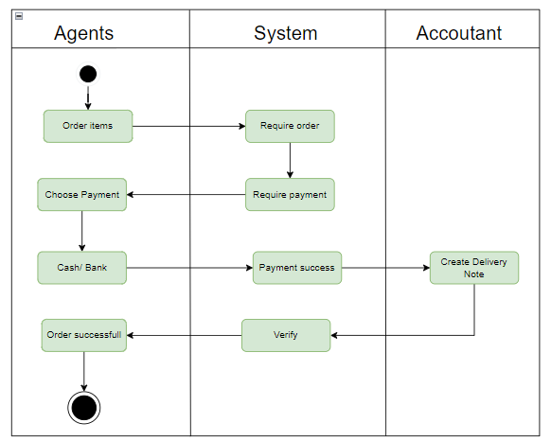
Activity Diagram Use Case: Payment

Slide 39
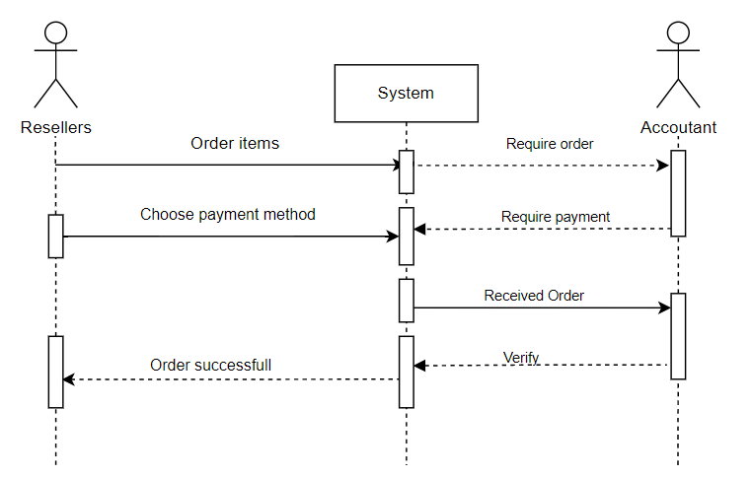
Sequence Diagram for Payment

Slide 40
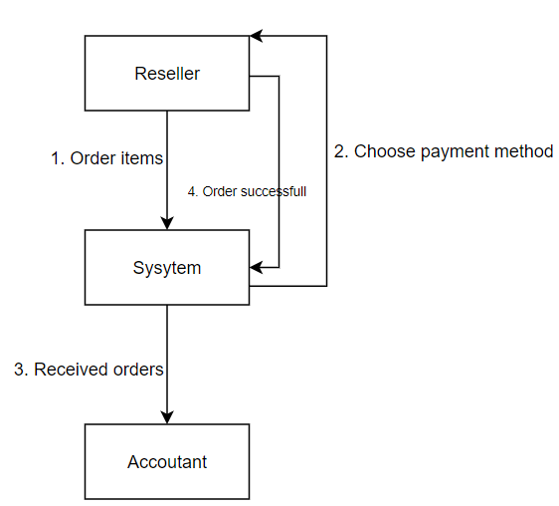
Collaboration for Payment

Slide 41
VIEW STATUS OF ORDERS

Slide 42
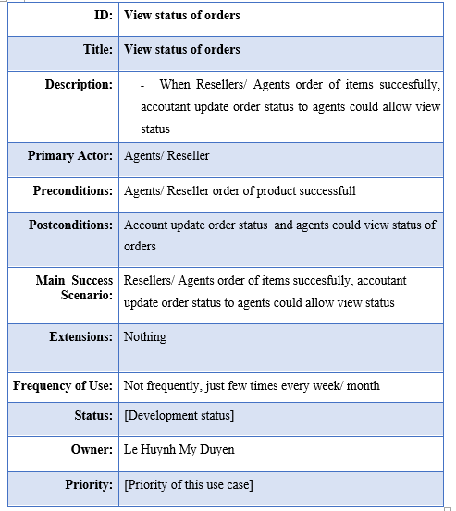
Use case description for View status of orders

Slide 43
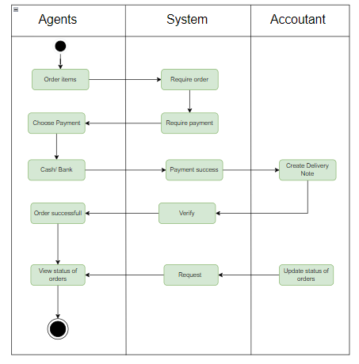
Activity Diagram Use Case:View status of orders

Slide 44
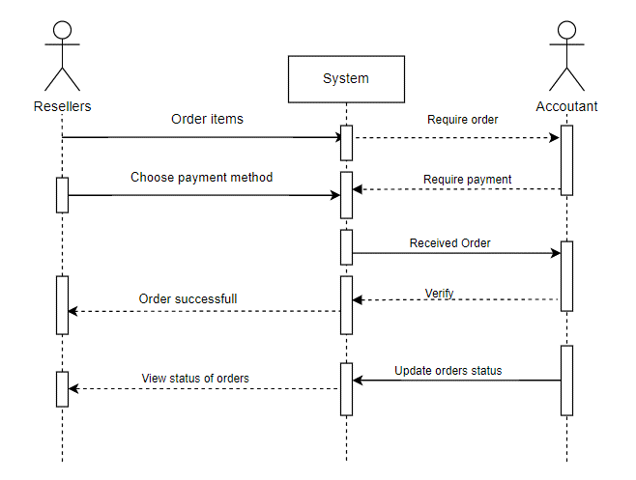
Sequence Diagram for View status of orders

Slide 45
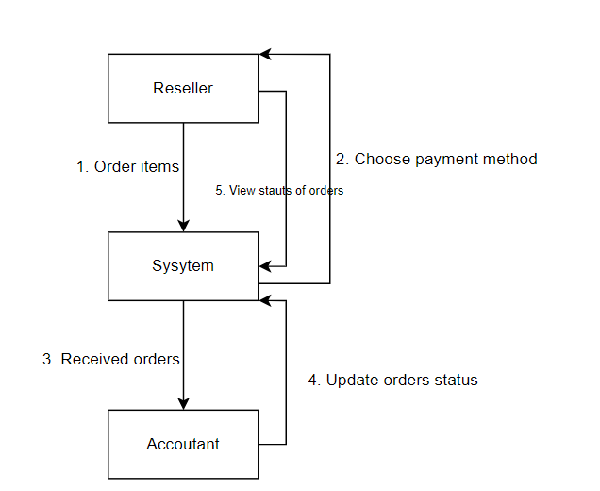
Collaboration for View status of orders

Slide 46

System Requirements Design

Slide 47
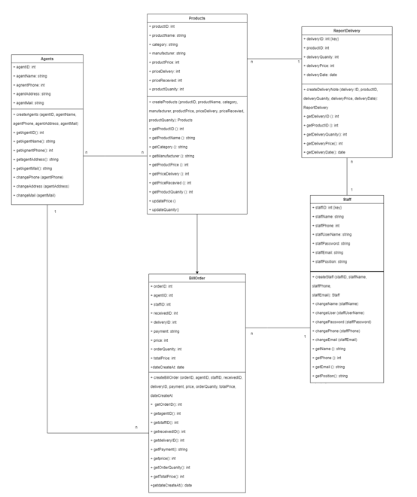
Design Class for Create Goods Delivery Note

Slide 48
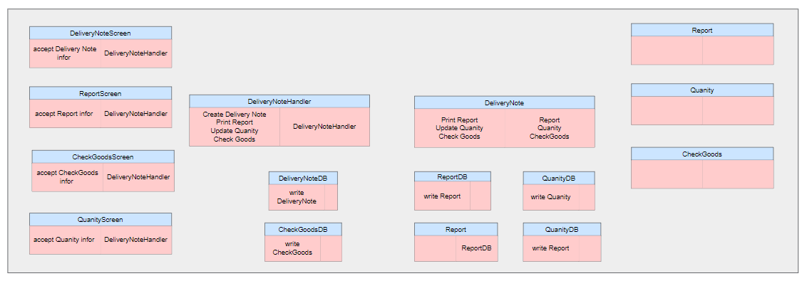
Data Access

Slide 49
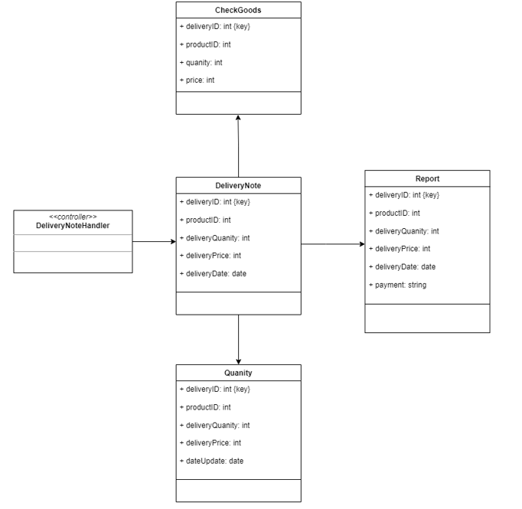
Domain design Class for Create Goods Delivery Note

Slide 50
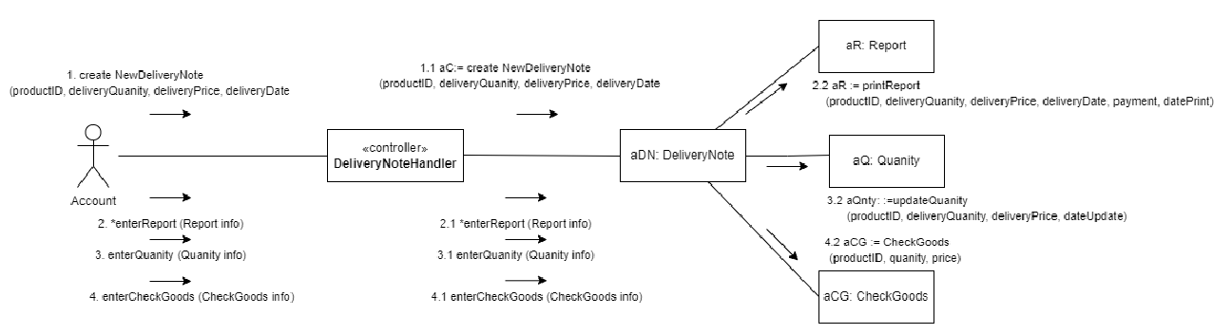
OOD with Communication

Slide 51
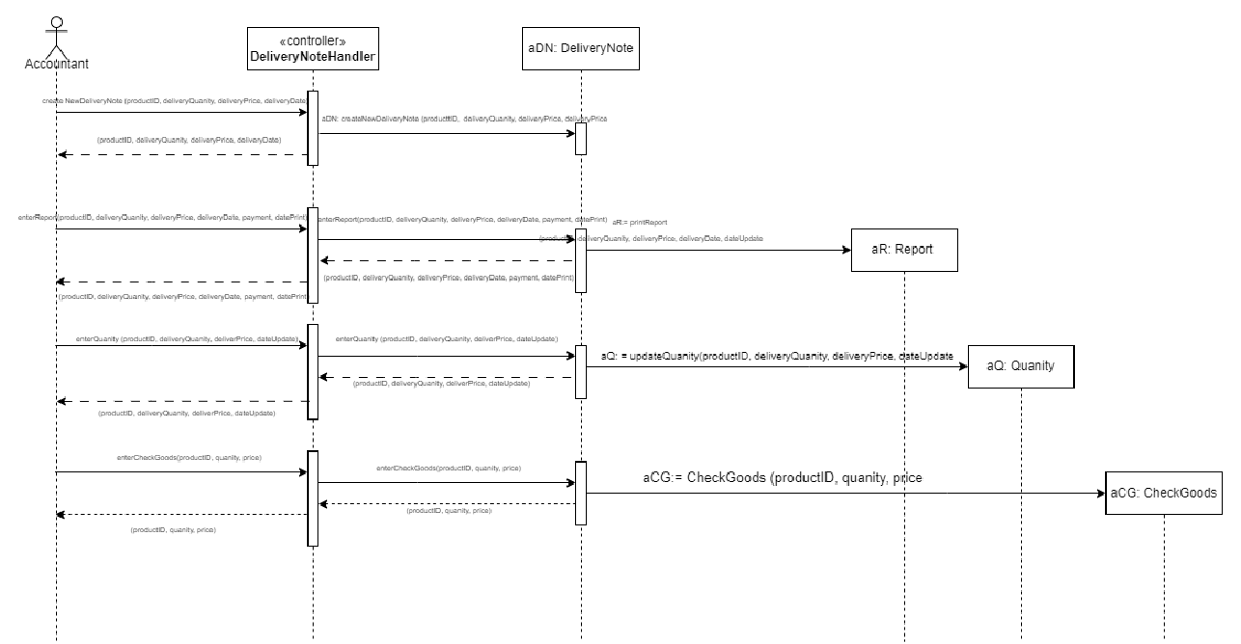
OOD with Sequence Diagram

Slide 52
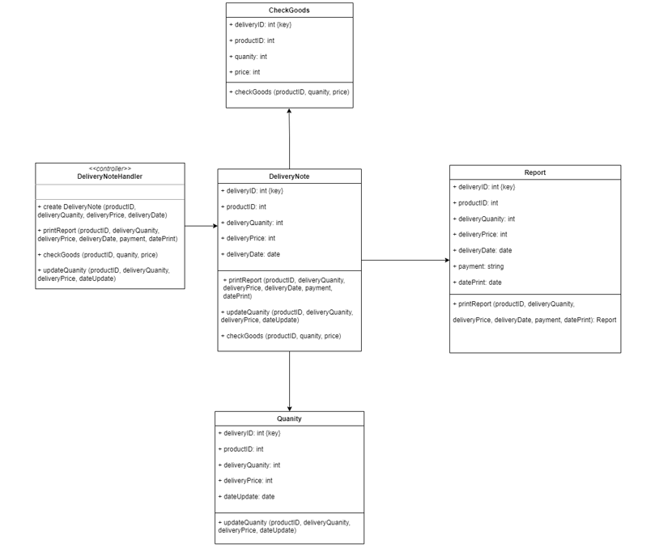
Final Design Class Diagram

Slide 53
Map persistent objects to the tables in a database

Slide 54
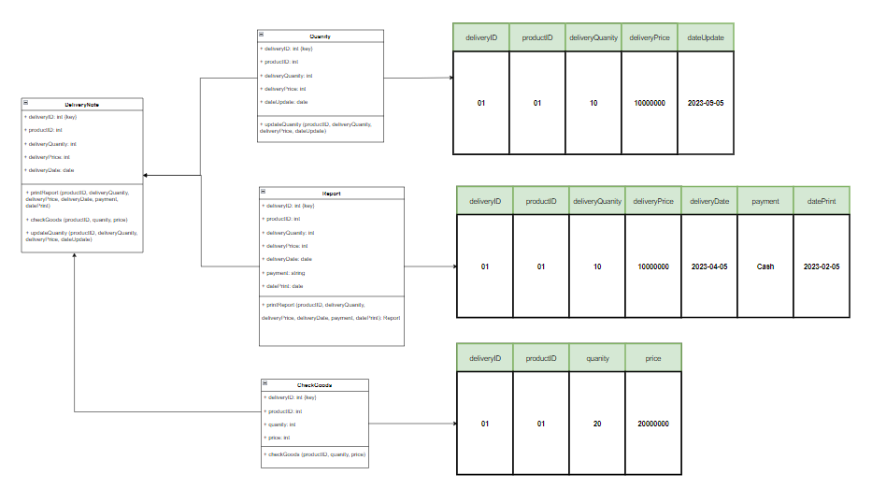

Slide 55
UI DESIGN

Slide 56
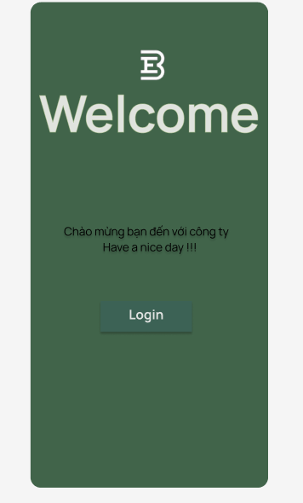
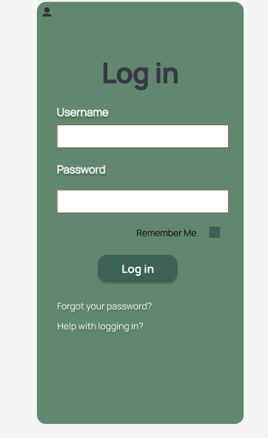
Accoutant Mobile Application

Slide 57
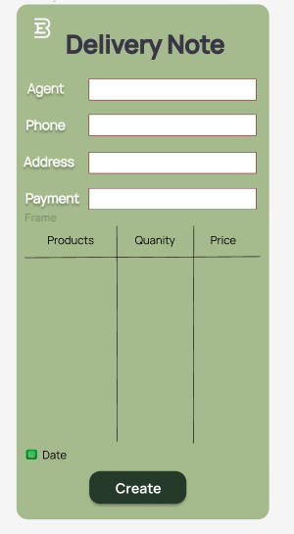
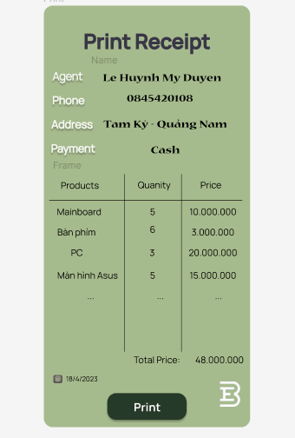
Create Delivery Note and Print Delivery Slips of Accoutant

Slide 58
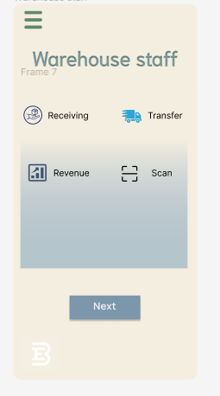
Main screen of Warehouse Manager

Slide 59
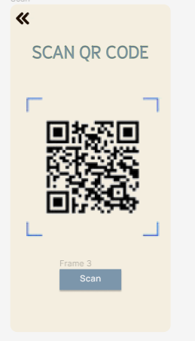

Scan barcode/ QR code of Warehouse staff

Slide 60
WINFORM

Slide 61

Create Goods Received Note

Slide 62
View/Update the payment status of agents

Slide 63
SQL CODE

Slide 64
CODING FOR THE DESIGN CLASS

Slide 65


Slide 66



Slide 67


Slide 68


Slide 69



Slide 70


Slide 71


Slide 72


Slide 73



Slide 74


Slide 75
SYSTEM TESTING

Slide 76


Test Plan

Slide 77


Test Case

Slide 78




IDIN DIN
THANK YOU
FOR YOUR TIME!

